Slide 1
Police Department Quarterly Update
Pleasantville Board of Trustees Meeting
August 8, 2022

Slide 2
Calls for Service
1059 Calls for Service this Quarter (down from 1287), including:
  Aided Calls: 97 (101)
  Alarm response: 39 (47)
  Auto Accident (Prop. Damage): 46 (41)
  Auto Accident (Pers. Injury): 5 (5)
  Disturbance: 9 (26)
  Domestic Dispute: 15 (12)
  Driving Complaint: 13 (5)
  Emotionally Disturbed Person: 3 (3)
  Hazardous Conditions: 33 (26)
  Location Check: 2 (11)
  Noise Complaint: 33 (25)
  Suspicious Person: 24 (20)
  Suspicious Auto: 13 (16)
  Welfare Check: 28 (34)

Slide 3
Patrol Division Activity

Slide 4
Community Policing
We have instituted Walking Posts in the Downtown area on both the Day tour (8:00am to 4:00pm) and 4:00pm to 12:00pm shifts.

Slide 5
Community Policing
Various members of the Department have attended and participated in Regional School Safety Symposiums.

Slide 6
Community Policing
July 14:
Det. Chiarlitti conducted a Stranger Danger presentation to the students at Tudor Time.

Slide 7
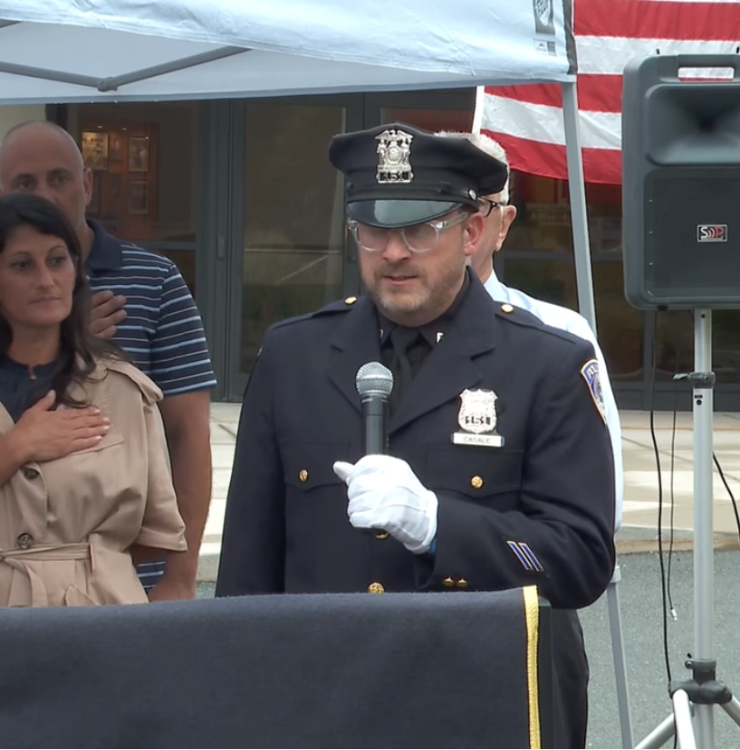
Community Policing

Slide 8
Calls of Note
  Beginning in mid-August, we have received two dozen calls for service regarding sick raccoons.
Notes:
Distemper
Communication with DEC

Slide 9
Calls of Note
August 9:
Following a traffic stop on Pleasantville Road, a 44-year-old Ossining resident was arrested for Forgery in the 2nd degree (D-Felony) after it was discovered that he was using counterfeit license plates on his vehicle. The defendant also received traffic summonses for operating out of class, driving with an open container on a public highway, and operating a motor vehicle which was uninsured, unregistered and uninspected.

Slide 10
Calls of Note
August 23:
A mother who was travelling for business reported that her adult daughter was making threats of self-harm.
Officers responded to the home to ensure her safety. Although she was reluctant to speak to them, with coordination between her therapist, the Mobile Crisis Team members and the officers, a safety plan for her continued well-being and mental health was achieved.

Slide 11
Detective Division Activity
Two cases were received by this Department (Larceny & Criminal Mischief, and Making Graffiti) in which the investigation led to the perpetrators being juveniles.
In both cases, Det. Sgt. Garcia was able to identify the juveniles, perform a deterrent interview and facilitate financial restitution for the victims.

Slide 12
Detective Division Activity

Slide 13
Staffing and Overtime
  We are attempting to clarify how we categorize Patrol Overtime in the Police Department.
Notes:
Originated from PDC transition

Slide 14
How We Schedule

Slide 15
How We Schedule
Notes:
Sergeants Only

Slide 16
How We Schedule

Slide 17
How We Schedule

Slide 18
How We Schedule

Slide 19
Patrol Staffing and Overtime
  Q3 2021: 769.5 hours
  Q3 2022: 1370.75 hours
Notes:
Had hired two officers in anticipation of future losses.

Slide 20
Staffing and Patrol Overtime
  Q3 Overtime: 769.5 hours
  Q4 Overtime: 1208.75 hours
  Q1 Overtime: 991 hours
  Q2 Overtime: 1586.5 hours
  Q3 Overtime: 1370.75 hours

Slide 21
Staffing and Overtime
Notes:
Tour Coverage remained even
Special Events stayed flat
School Guard Dropped – New Hires
Training decreased but will rise

Slide 22
Personnel and Staffing
  Two of our Sergeants will serve their last day before the end of the calendar year.

Slide 23
Personnel and Staffing
  PO Juan Alonzo was hired in early July.
  Jonathan Smith was promoted to Detective.

Slide 24
Personnel and Staffing
  Three new Crossing Guards have been hired:
    Romer Avenue and the exit from the MS
    Ashland Avenue and the exit from the MS
    Fill-in (currently working afternoons)

Slide 25
Personnel and Staffing
  We are hopeful to receive the results of the Community Service Worker (CSW) examination in the next few months.
Notes:
Permanent appointment of current CSW
New Hire

Slide 26
Training
  Detective Chiarlitti attended the SNYPJOA Conference and participated in workshops related to any manner of Youth Officer responsibilities.
  Officer Charles attended Crisis Intervention Training.
Notes:
SNYPJOA: Perspective of an Addict – Changing the Narrative
School Safety and interaction

Slide 27
Training
  Sgt. Zane attended Firearms Instructor School and is now a certified instructor.
  Officer Casale attended Officer Wellness training.
  Sgt. Caccamise attended 911 Diversion Training.

Slide 28
Areas of Concern
  “Porch Pirates”
  Catalytic converter thefts

Slide 29
Areas of Concern / PD Project Updates
  New York State Accreditation
Notes:
Still no communication from NYS on our submitted application
Will be arriving at a working calendar to update R&R

Slide 30
Areas of Concern / PD Project Updates
  Body Worn Cameras.
Notes:
DCJS funding for BWC
New Policy must be in place
Offers $2000 /
Responses will come next year

Slide 31
Areas of Concern / PD Project Updates
  Adding Electric Vehicles to the fleet.
Notes:
Interacted with Electrician and reviewed NYS Contract
Looking for Board Input

Slide 32
Areas of Concern / PD Project Updates
  PD Radio Communications

Slide 33
Areas of Concern / PD Project Updates
  Village Emergency Plans
Notes:
Thanks to Lt. Gilmartin
Circulated among other Village first responder organizations
Follows ICS

