Slide 1
Police Department Quarterly Update
Pleasantville Board of Trustees Meeting
April 25, 2022

Slide 2
Calls for Service
1209 Calls for Service this Quarter (up from 942), including:
Aided Calls: 86
Alarm response: 54
Auto Accident (Prop. Damage): 47
Auto Accident (Pers. Injury): 5
Disturbance: 12
Domestic Dispute:12
Driving Complaint: 5
Emotionally Disturbed Person: 7
Hazardous Conditions: 58
Location Check: 12
Suspicious Person: 10
Suspicious Auto: 8
Welfare Check: 20

Slide 3
Community Policing

Slide 4
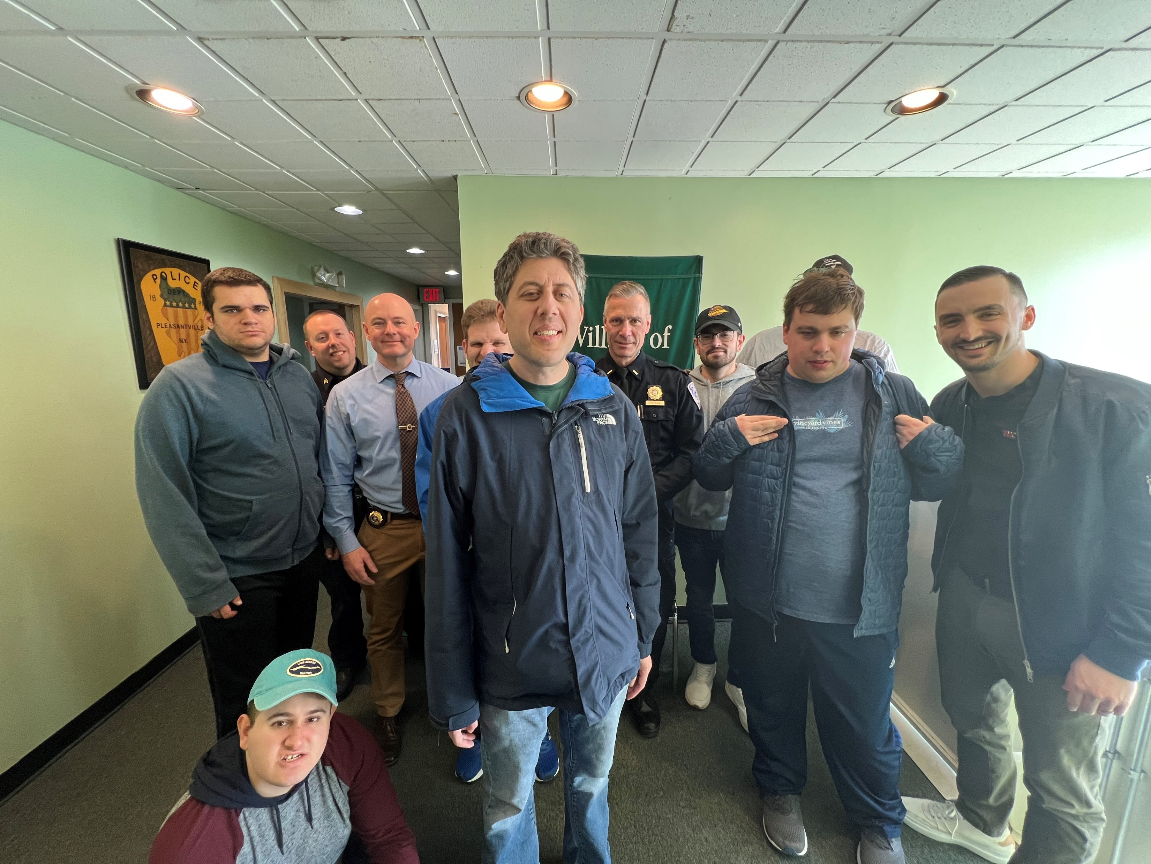
Community Policing
Notes:
October 7

Slide 5
Community Policing
We have commenced the school walk-through program.
The warm weather will continue to provide opportunities for our officers to interact with the public
Spring sports
Community events
Visible presence

Slide 6
Calls of Note
January 2:
A four-week investigation led to the arrest of a 22-year old employee of the Raw Cloud House on Marble Avenue. Det. Chiarlitti discovered he had been supplying an underage female with alcohol, marijuana and vape products, while developing an inappropriate relationship with her.
He was charged with Endangering the Welfare of a Child, as well as Unlawfully Dealing with a Child in the 1st and 2nd degree.

Slide 7
Calls of Note
February 1:
A Village resident reported to the Police Department that her purse had been stolen from her vehicle while it was parked on Wheeler Avenue in front of the Black Cow. Officers were able to track the suspect via CCTV cameras to the MTA train platform, where he was found to still be in possession of the victims’ purse.
The 58-year old White Plains man was arrested by Officer Velardo and charged with Grand Larceny in the 4th degree and Criminal Possession of Stolen Property in the 4th degree, both felonies.

Slide 8
Calls of Note
February 27:
After being reported by a passerby, officers were dispatched to Bedford Road for a report of a man stopped in the roadway, apparently asleep at the wheel. PO Charles, with the assistance of PO Burns, arrested the driver, a 28-year old Brooklyn man for DWI.
after locating him asleep at the wheel of his vehicle, stopped in the middle of Bedford Road. The Officers had to break a window on the vehicle in order to gain access to the operator who was unconscious.

Slide 9
Calls of Note
March 30:
In August of 2021, Det./Sgt Garcia began an investigation after a South Salem resident reported that a check addressed to him was stolen out of his vehicle in Pleasantville and deposited into the account of an individual not known to him.
After a lengthy investigation, a 26- year old Pleasantville resident was identified and arrested by Det / Sgt. Garcia and charged with Grand Larceny 4th degree and Criminal Possession of Stolen Property 4th degree.

Slide 10
Staffing and Overtime
Q2 Overtime: 804.5 hours
Q3 Overtime: 841.75 hours
Q4 Overtime: 1279 hours
Q1 Overtime: 991 hours

Slide 11
Staffing and Overtime
Q1 2021: 814.5 hours
Q1 2022: 991 hours

Slide 12
Staffing and Overtime

Slide 13
Personnel Complaints
One

Slide 14
Personnel and Staffing
Shawn Lyon retired on February 18.

Slide 15
Personnel and Staffing
Eric Byrwa assumed the duties of the Administrative Sergeant position.
Joseph Zane was promoted from Detective to Patrol Sergeant.
We have not replaced Sgt. Zane in the Detective Division, but anticipate doing so in the near future.

Slide 16
Personnel and Staffing
School Guard hiring and retention continues to be an issue.

Slide 17
Training
Our Firearms Instructors recertified as Patrol Rifle Armorers
PO Casale continued his training as a Peer Support Officer by attending the Advanced Assisting Individuals in Crisis School

Slide 18
Training
Sergeant Zane is a NYS certified police instructor after attending Instructor Development School.
Sgt Byrwa continued his training to become an Implicit Bias Awareness Instructor.

Slide 19
Training
PO Cole-Hatchard and PO Velardo both attended the Crisis Intervention Training Course.

Slide 20
Training
With the assistance and cooperation of the Pleasantville Schools, we began a new training and awareness block for officers to build familiarity with school personnel and locations.

Slide 21
Areas of Concern
Personnel and Staffing
Radio Communications: we are currently examining options regarding our portable and car radios.
Updating of the Policies and Procedures.

Slide 22
Recommendation #1
Enhanced Training for Police Officers

Slide 23
Police Reform Goal #1: Enhanced Training for Police Officers
Recommendation #1-A
Implicit Bias Training
Commit to ongoing training for every police officer to recognize and address discrimination or bias in all interactions.
Provide a combination of outside instruction and in-house training to ensure broad perspective, continued conversations, and personal awareness of bias.
Annually evaluate training to assess effectiveness and identify opportunities for improvement.
Timeline: Immediate
Procedure: Review best practices in the region, gather and implement the most current training materials available, and coordinate with Westchester County to participate in shared training.

Slide 24
Police Reform Goal #1: Enhanced Training for Police Officers
Recommendation #1-B
De-Escalation Training
Train officers to respond to calls with the initial goal of de-escalation.
Support officers with training to focus on specific situations—including people with mental illness, mental health crisis, or experiencing trauma.
Evaluate opportunities with other law enforcement partners for crisis intervention training for mental health emergencies.
Work with Westchester County to gain support for the mental-health intervention programs proposed in the County reform recommendations.
Timeline: Immediate
Procedure: Review best practices in the region, gather and implement the most current training materials available, and coordinate with Westchester County to participate in shared training.

Slide 25
Police Reform Goal #1: Enhanced Training for Police Officers
Recommendation #1-C
Use of Force Policies and Training
Evaluate current of force training and ensure compliance with the Department of Justice requirements.
Undertake a detailed review with the Village Board and police administration of the existing use of force policy, revising as needed to reflect recent changes in NY State law and the results of the review process.
Timeline: Immediate
Procedure: Review best practices in the region, gather and implement the most current training materials available, and coordinate with Westchester County to participate in shared training.

Slide 26
Police Reform Goal #1: Enhanced Training for Police Officers
Recommendation #1-D
Training Schedules and Curriculum
Develop and maintain an outline of officer training programs, describing the sequence and schedule of training provided for new recruits and officers—showing initial training, annual training, periodic training, and opportunities for specialized training.
Develop and maintain a training curriculum—identifying the subjects, methods, and sources of training materials and programs.
Timeline: Immediate
Procedure: Review and codify best practices in the region, current training materials, and shared training available through Westchester County.

Slide 27
Recommendation #2
Communication, Community Outreach & Engagement

Slide 28
Police Reform Goal #2: Communication, Community Outreach, & Engagement
Recommendation #2-A
Outreach to Community Groups
Continue to identify and engage community groups with identifiable needs.
Strive to identify the best means of communication with each group.
Expand registrants in the existing Police Department program for community members to register information on household members with special needs, mental health issues, and/or medical issues to assist with Police response.
Establish a committee to provide ideas and advice about improving police-community relations—and to consider ways to encourage and analyze feedback about interactions with police.
Timeline: Immediate
Procedure: Village board to establish an advisory committee; police administration and Village administration to collaborate on a communications campaign to engage community groups and educate the public on the registrant program.

Slide 29
Police Reform Goal #2: Communication, Community Outreach, & Engagement
Recommendation #2-B
Increase Community Policing
Create a more visible presence for officers—encouraging foot and bicycle patrols, and enhancing public interactions in the downtown and during public events.
Timeline: July 1, 2021
Procedure: Examine scheduling and staffing, seeking opportunities to enhance visibility; police administration to report to the Village board and administration on opportunities within the current staffing budget and potential costs of opportunities that would require additional staff or overtime.

Slide 30
Police Reform Goal #2: Communication, Community Outreach, & Engagement
Recommendation #2-C
Quarterly Updates from the Police Department
Provide updates on department operations, training, statistics on crime and arrests, and other matters of public interest presented quarterly at public Village Board meetings.
Timeline: Immediate
Procedure: Police Chief and a Lieutenant will be scheduled to present at the second Village Board meeting in January, April, July, and October.

Slide 31
Police Reform Goal #2: Communication, Community Outreach, & Engagement
Recommendation #2-D
Improve Accessibility of Police Department Resources
Promote contact information, downloadable forms, and department resources on Police Department web page.
Encourage registration in Village “News & Announcements” e-mail list.
Initiate and post a weekly summary of police blotter activities to police web page.
Timeline: September 1, 2021
Procedure: Communications campaign to promote police web resources and to gather public opinion on communications. Start weekly posting of blotter first week of May 2021.

Slide 32
Recommendation #3
Policies and Procedures

Slide 33
Police Reform Goal #3: Policies & Procedures
Recommendation #3-A
Policies and Procedures should be made more transparent to the public
Undertake a full review of current Pleasantville police policies and procedures.
As appropriate, make policies public and available on the police web page – including the complaint procedures and the use-of-force policy
Timeline: TBD
Procedure: Evaluate resources required to complete comprehensive review and update.

Slide 34
Police Reform Goal #3: Policies & Procedures
Recommendation #3-B
Personnel Complaint Review Procedure
• Incorporate review by personnel outside of the police department.
Timeline: Immediate
Procedure: The Village Administrator will be notified by the Police Chief within three (3) business days of receipt of a complaint about the Department or its officers.
The Chief will maintain timely communication with the Village Administrator about ongoing investigations and findings.
Prior to finalizing disciplinary actions, the Chief will brief the Village Administrator on the proposed actions and their justification.
Every six months, the Chief will meet with the Village board in executive session, providing a summary of all complaints received, the results of investigations, and disciplinary actions.
Ongoing: Schedule a standard executive session with the Village board at the second meeting in January and July. Review policies in other jurisdictions for managing police complaints and discipline.

Slide 35
Police Reform Goal #3: Policies & Procedures
Recommendation #3-C
Use of Force Review Process
Enhance internal review process when use of force is utilized to include 1) Debrief within the department, 2) Debrief to Village administration, and 3) Identification of potential training needs/opportunities.
Timeline: Immediate
Procedure: Amend General Orders to reflect the above.

Slide 36
Police Reform Goal #3: Policies & Procedures
Recommendation #3-D
Review Future Implementation of Body Cameras.
The Village board, Village administration, police administration, and PBA should review the benefits, issues, policies and costs associated with potential future implementation of body cameras for officers.
Timeline: Initial review by December 2021, annual review/update thereafter
Procedure: Solicit and assess information from the County and other departments in the region who have implemented body camera programs or are considering them.

Slide 37
Recommendation #4
Enhanced Collection and Analysis of Data

Slide 38
Police Reform Goal #4: Enhanced Collection and Analysis of Data
Recommendation 4A-D
Comprehensive Collection of Demographic and Police Action Data
Acquire and implement new data collection software to capture demographics, police actions, and information to ensure accessibility and usability of data. [Note: The Department is part of a shared-service effort with Westchester County to identify and license a new law enforcement software platform.]
Comply with NYS mandates for data collection.
Provide quarterly updates on police data at public Village Board meetings.
Timeline: June 1, 2022 (pending shared services timeline)
Procedure: Research and migrate police patrol software due to end of service of current platform.

