Slide 1
Police Department Quarterly Update
Pleasantville Board of Trustees Meeting
February 14, 2022

Slide 2
Calls for Service
1209 Calls for Service this Quarter (up from 942), including:
Aided Calls: 112
Alarm response: 50
Auto Accident (Prop. Damage): 40
Auto Accident (Pers. Injury): 3
Disturbance: 14
Domestic Dispute:9
Driving Complaint: 5
Emotionally Disturbed Person: 2
Hazardous Conditions: 28
Location Check: 256
Suspicious Person: 28
Suspicious Auto: 7
Welfare Check: 35

Slide 3
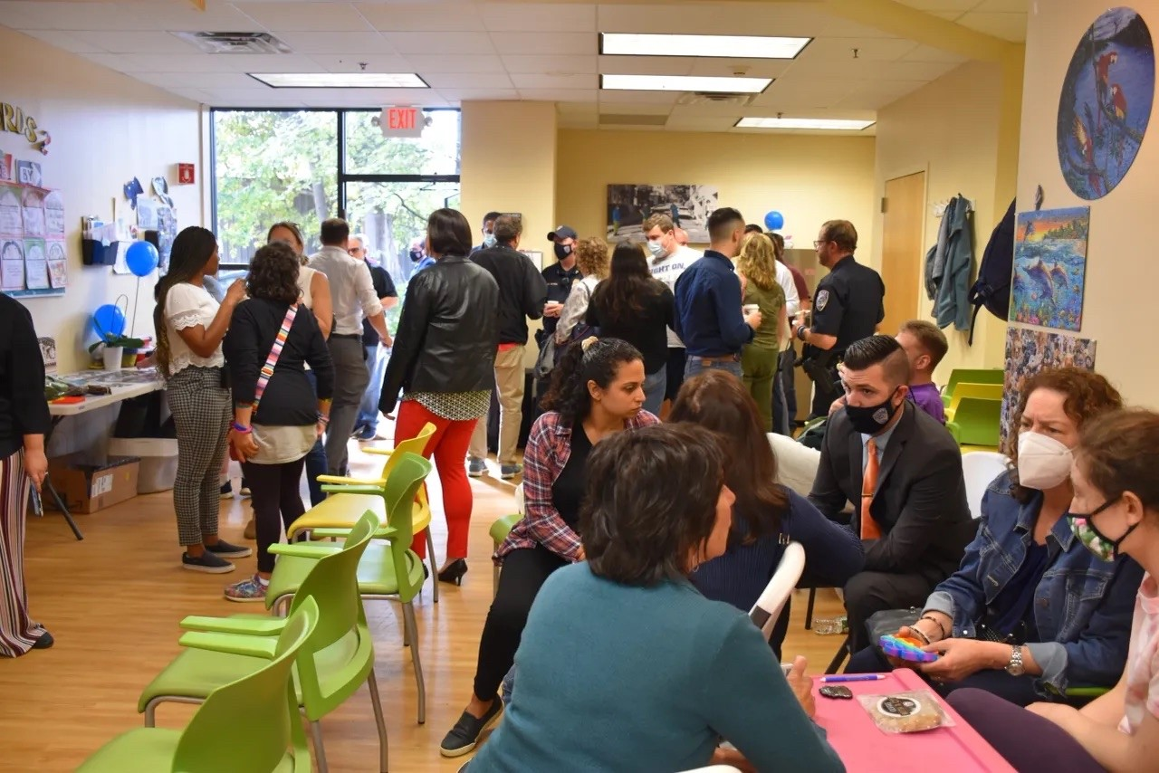
Community Policing
Notes:
October 7

Slide 4
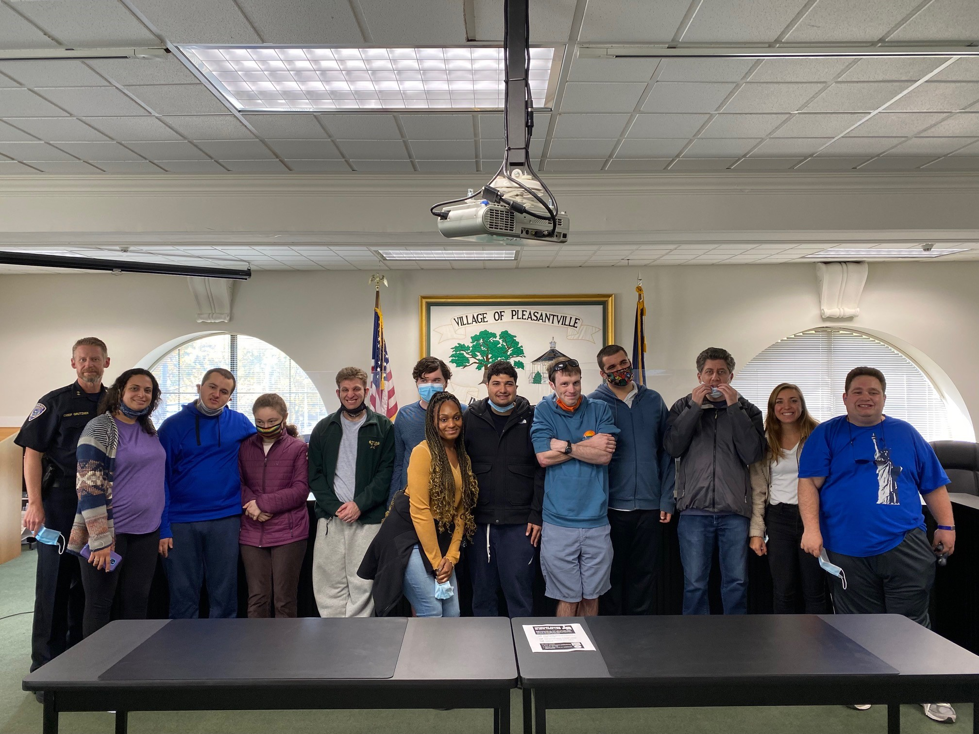
Community Policing
Notes:
October 18

Slide 5
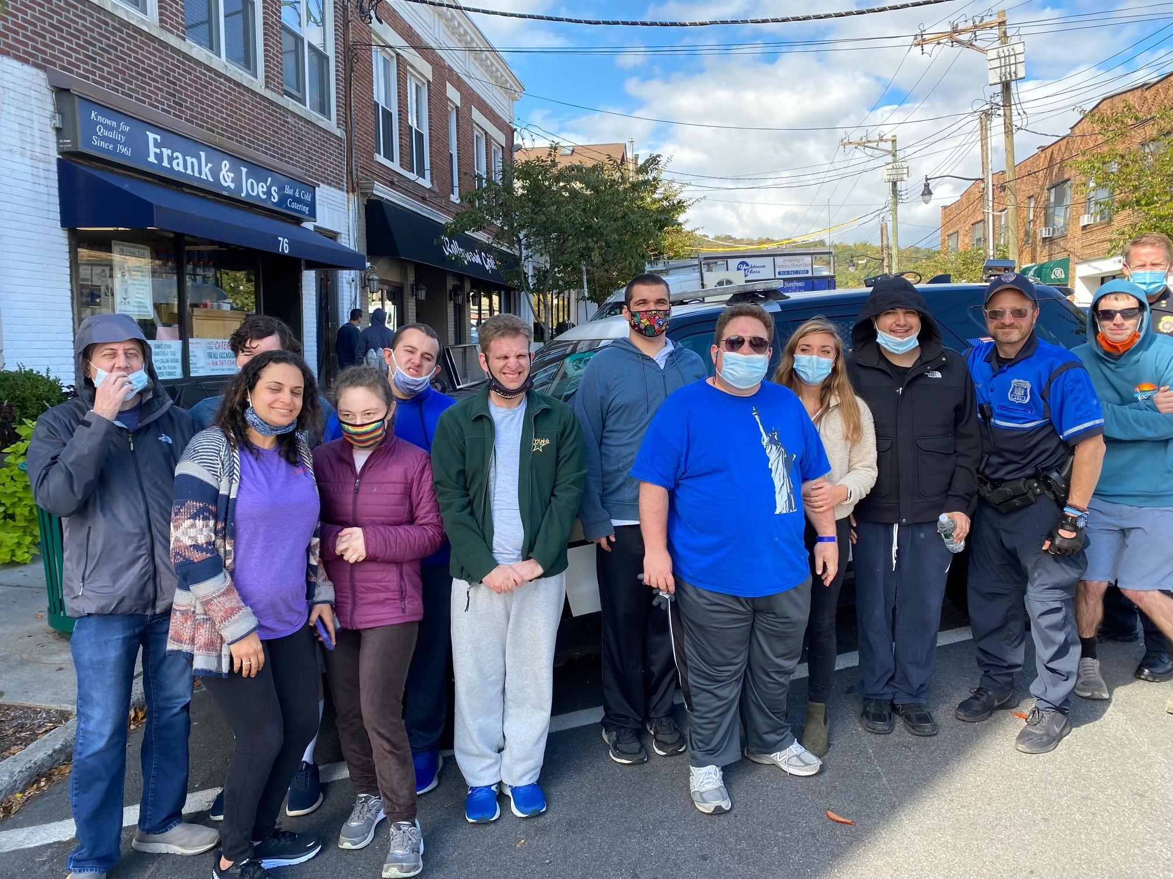
Community Policing

Slide 6
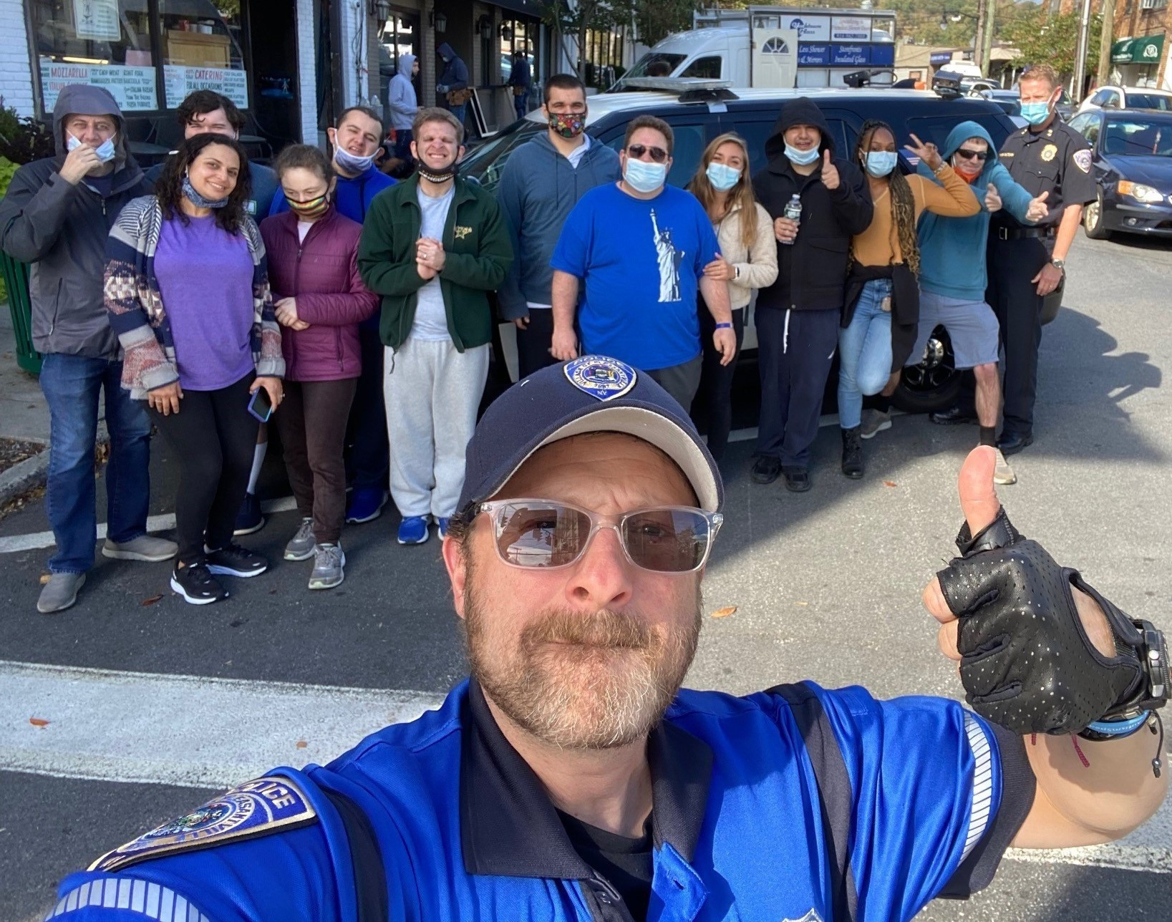
Community Policing

Slide 7
Community Policing
We have continue to partner with the schools for safety planning and drills.
We will be expanding our presence in the schools.

Slide 8
Calls of Note
October 4:
This Department received a 911 call reporting a young man sitting on the bridge on Bedford Road that spans the Saw Mill River Parkway. The caller further reported that his legs were currently on the Bedford Road side and that there appeared to be another young person speaking to him, attempting to get him off the bridge, but to no avail.

Slide 9
Calls of Note
October 4:
Officer Peter Burns responded and found the parties as reported. As Officer Burns approached, the young man began to swing his legs over to the Parkway side. Officer Burns grabbed the young man and pulled him out of harm’s way.
The young man’s mother was contacted and he was transported to the hospital.

Slide 10
Calls of Note
October 20:
A 19 year-old man with special needs was in distress, physically acting out and breaking windows in his home.
Sgt. Woods, PO Charles, Det. Chiarlitti, Lt. Wollman and Det. Sgt. Garcia were able to safely control his movements. Upon the arrival of the paramedic, the young man was administered medication to sedate him, and transported to the hospital without injury or further incident.

Slide 11
Calls of Note
November 14:
During the investigation of a late-night domestic disturbance, it was discovered that the man involved was in possession of numerous firearms, including:
a modified AK-47 & three (3) Modified AR-15’s
eleven (11) high capacity magazines, capable of holding more than ten rounds of ammunition.
The suspect was charged with two (2) D-Felonies for Criminal Possession of a Weapon 3rd degree.

Slide 12
Calls of Note
December 1:
We received a 911 call from a restaurant on Bedford Road reporting that they had been robbed. An unidentified perpetrator placed an order at the counter. As his transaction was being completed, he shoved the employee and grabbed cash out of the register. He fled the restaurant and left the scene in a vehicle being operated by an accomplice. Although the employee had spent a few minutes taking the perpetrator’s order, he was unable to give a good description because the perpetrator was wearing a hat and a facemask.

Slide 13
Calls of Note
December 1:
However, using video evidence and in partnership with the Westchester County Real Time Crime Center and the FBI’s Safe Streets Task Force, we were able to discover the registration of the vehicle and arrest the two people responsible.
The accomplice was charged with Criminal Facilitation in the 4th degree. The perpetrator was charged with Robbery in the 2nd degree; a class D Felony.

Slide 14
Staffing and Overtime
Q2 Overtime: 804.5 hours
Q3 Overtime: 841.75 hours
Q4 Overtime: 1279 hours

Slide 15
Staffing and Overtime
Notes:
Sick time down; Special Events, COVID, School Guard UP
Special Events: Ragamuffin Parade, Halloween, Varsity Football Games, Holiday Sing
Reimbursables
Training

Slide 16
Enforcement Activity

Slide 17
Personnel Complaints
None

Slide 18
Personnel and Staffing
We continue to discuss and prepare for a number of retirements anticipated in the next twelve months.

Slide 19
Personnel and Staffing
School Guard hiring and retention continues to be an issue.

Slide 20
Training
Firearms Requalification
Three of our Sergeants (Woods, Gilmartin and O’Keefe) attended Unified In-service Training for Supervisors, which includes training on Legal Updates, as well as Leadership and Supervision training.

Slide 21
Training
PO Holly is now a certified Police Trainer after completing Instructor Development School (IDS)
Sergeant Byrwa received training as a Community Resource Officer.
PO Casale attend a two-day officer wellness and peer support training program.

Slide 22
Areas of Concern
Personnel and Staffing
Radio Communications: we are currently examining options regarding our portable and car radios.
Updating of the Policies and Procedures.

Slide 23
Department Goals
GOAL #1
Increase presence of officers in Pleasantville Union Free School District buildings and at school events to enhance safety of students and staff through relationship-building and familiarity.

Slide 24
Department Goals
GOAL #1
Walkthroughs
Drills

Slide 25
Department Goals
GOAL #2
Increase outreach efforts to engage with, and build trust within, segments of our community who may remain cautious interacting with law enforcement.

Slide 26
Department Goals
GOAL #2
Spanish speaking community
Community – Police Communication Advisory Committee
CRO integration
Event Hosting
Principled Policing

Slide 27
Department Goals
GOAL #3
Enhance and improve response to calls for mental health service and / or involving persons with special needs.

Slide 28
Department Goals
GOAL #3
Partnership with the Nicholas Center
CIT Training
County Crisis Team

Slide 29
Department Goals
GOAL #4
Participate in outreach, communication and training to properly respond to incidents regarding bias. Update the public regularly on bias incidents as appropriate.

Slide 30
Department Goals
GOAL #4
Quarterly reports
Training
DEI Committee

Slide 31
Department Goals
GOAL #5
Direct Training of Officers to improve the quality of the service provided to the public and reduce liability.

Slide 32
Department Goals
GOAL #5
Power DMS

