Slide 1
Police Department Quarterly Update
Q1 2024
Pleasantville Board of Trustees Meeting
April 29, 2024

Slide 2
Calls for Service
702 Calls for Service this Quarter (down from 769), including:
  Aided Calls: 82 (100)
  Alarm response: 51 (26)
  Auto Accident (Prop. Damage): 51 (41)
  Auto Accident (Pers. Injury): 3 (9)
  Disturbance: 18 (13)
  Domestic Dispute: 5 (13)
  Driving Complaint: 3 (4)
  Emotionally Disturbed Person: 11 (2)
  Hazardous Conditions: 27 (27)
  Location Check: 0 (1)
  Noise Complaint: 17 (15)
  Suspicious Person: 15 (14)
  Suspicious Auto: 7 (18)
  Welfare Check: 21 (23)

Slide 3
Patrol Activity: Q1 2023 –
Q1 2024

Slide 4
Community Policing
February 7: Lt. Gilmartin, Sgt Byrwa and Det Chiarlitti read to students at BRS.

Slide 5
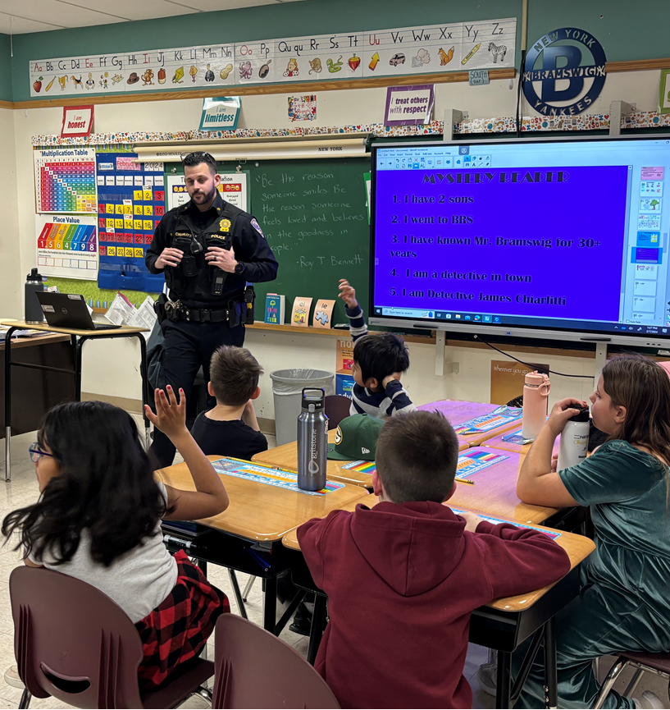
BRS “Read Aloud Day”

Slide 6
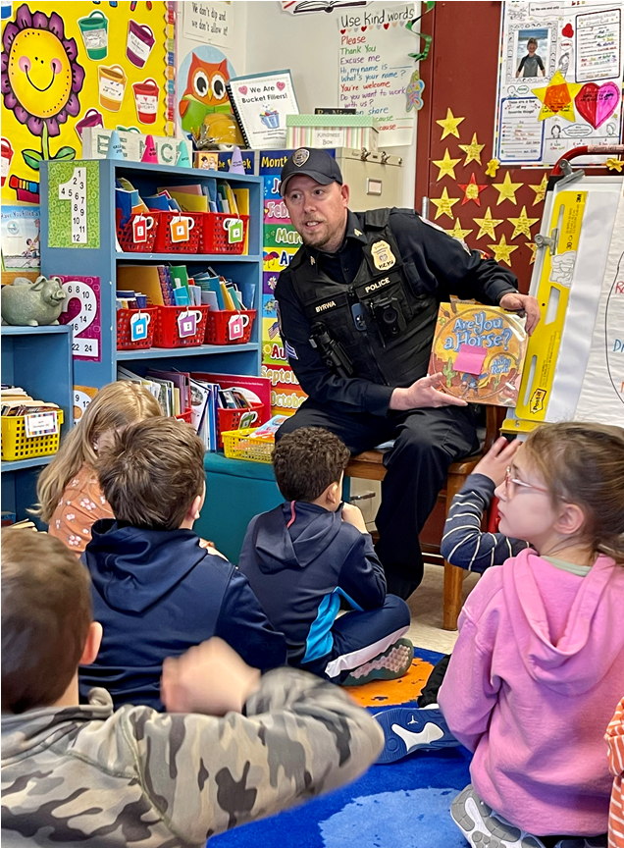
BRS “Read Aloud Day”

Slide 7
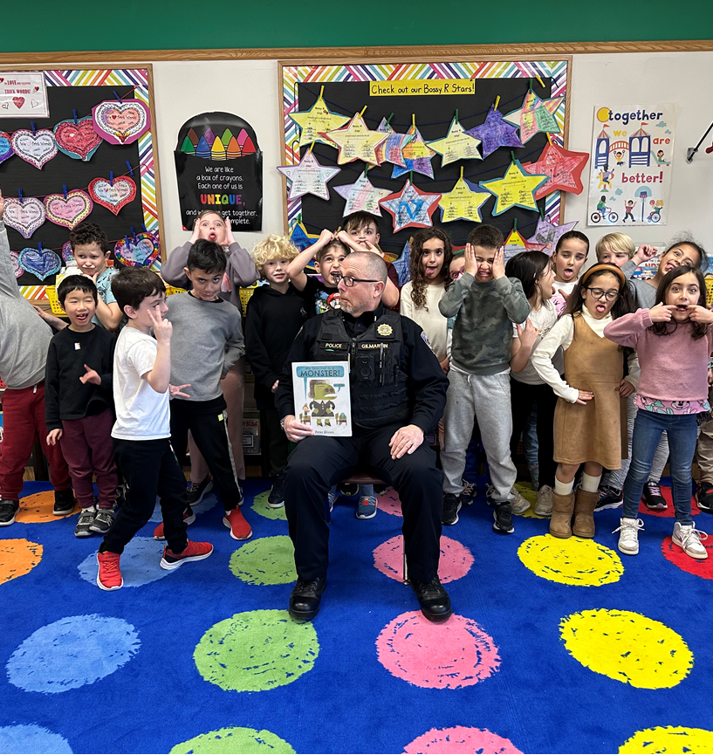
BRS “Read Aloud Day”

Slide 8
Community Policing
February 8: The Detective Division (Det. Sgt. Zane, Det. Chiarlitti and Det. Smith) presented on Internet Safety to clients and staff at Select Human Services.

Slide 9
Calls of Note
March 27:
An alert teller noticed suspicious issues on a check that a man was attempting to cash and notified police. Following an investigation on scene, a 20-year-old from the Bronx was arrested and charged with Criminal Possession of a Forged Instrument, as the check had been altered. He was booked and released with a court appearance date.

Slide 10
Staffing and Overtime
  2023 Q1: 1639.5 hrs.
  2023 Q2: 1166.5 hrs.
  2023 Q3: 1104 hrs.
  2023 Q4: 1643 hrs.
  2024 Q1: 1162.5 hrs.

Slide 11
Patrol Overtime

Slide 12
Personnel and Staffing
  For a brief period (1 day) we had all of our permanent School Guards back on post.

Slide 13
Training
PO Velardo attended a three-day Car Seat Installation School and is now certified to assist families.
Lt. Wollman, Lt. Gilmartin and I attended training with Hope Not Handcuffs.

Slide 14
Training
Det. Chiarlitti participated in a webinar regarding Death Investigations.
Det. Sgt. Zane and PO Alonzo participated in a ghost gun investigation workshop.

Slide 15
Officer Wellness
The Department has partnered with Guardian Revival to development an Officer Wellness Program.
Appointed Officer Velardo and Sgt. Casale were appointed as department Wellness Leaders.

Slide 16
Projects of Note
Records Management System

Slide 17
Projects of Note
Radio Communications

Slide 18
Goals 2024
Fleet

